Slide 1
Discrete Mathematics, Chapter 4: Number Theory and Cryptography
Number Theory: Branch of mathematics concerned with properties of the positive integers (1, 2, 3, …).
Nouman M Durrani, FAST NUCES, Karachi.
Courtesy: Richard Mayr

Slide 2
Outline
1 Divisibility and Modular Arithmetic
2 Primes and Greatest Common Divisors
3 Solving Congruences
4 Cryptography

Slide 3
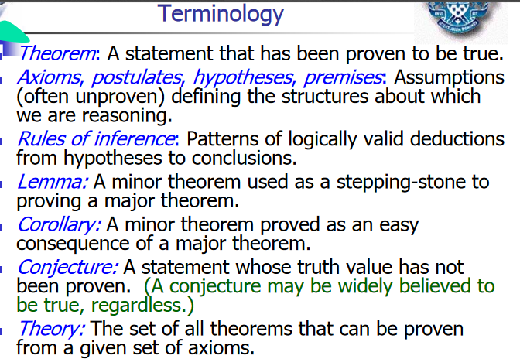

Slide 4
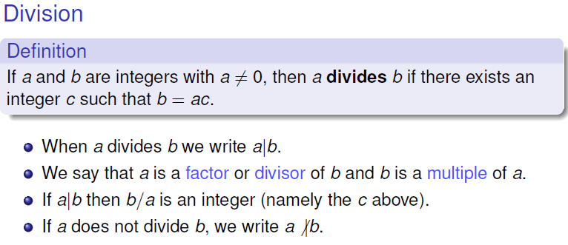


Slide 5
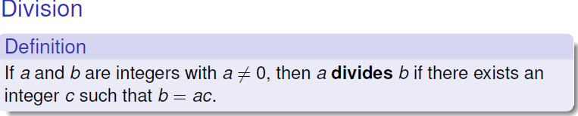
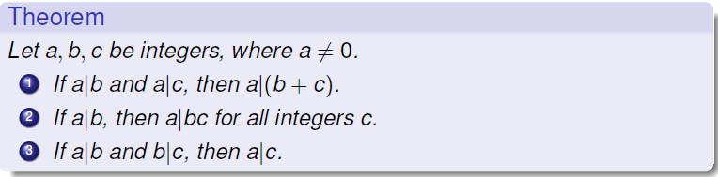
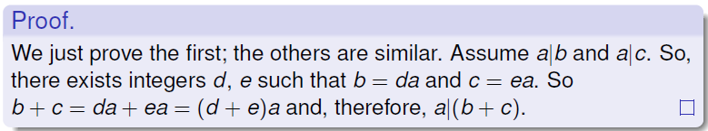
Example: 3 | 6 and 3 | 9, so 3 | 15.
Example: 5 | 10, so 5 | 20, 5 | 30, 5 | 40.
Example: 4 | 8 and 8 | 24, so 4 | 24.

Slide 6
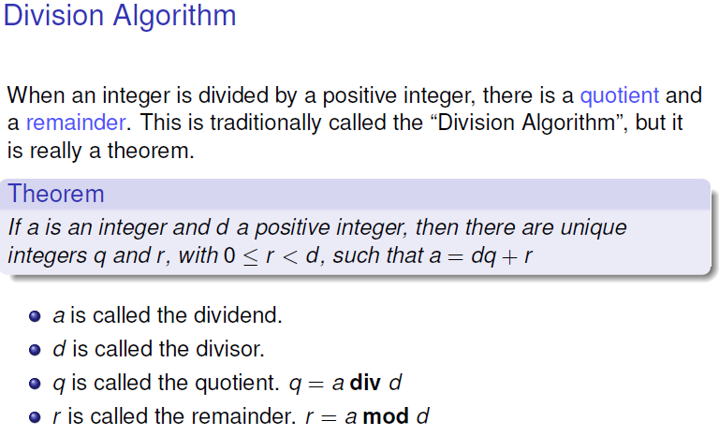
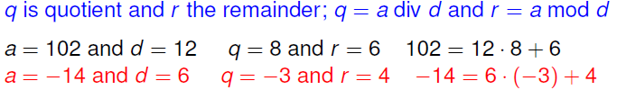

Slide 7
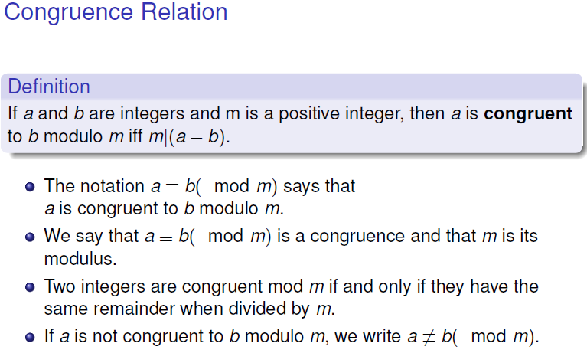

Slide 8
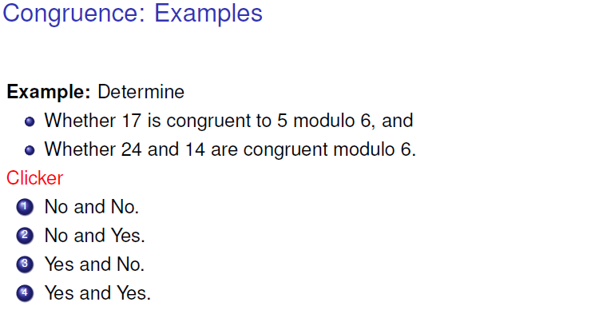

Slide 9


Slide 10
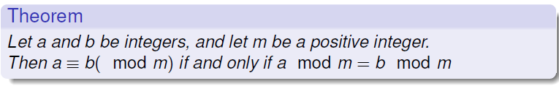
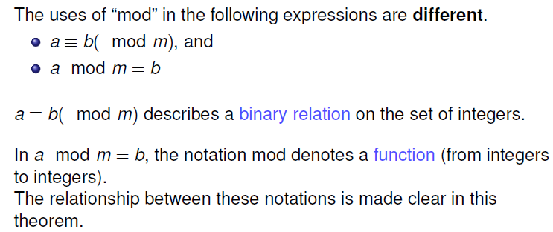
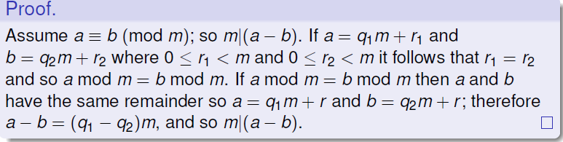

Slide 11
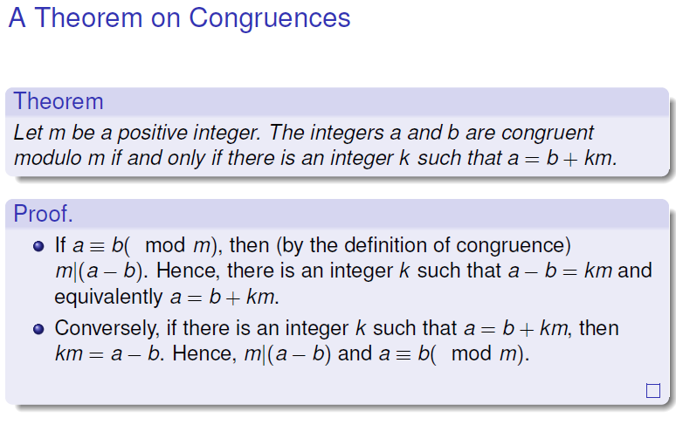

Slide 12
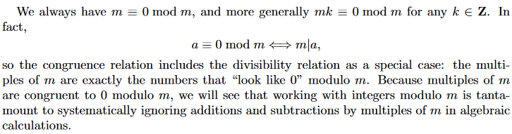
m= 0 mod m

Slide 13
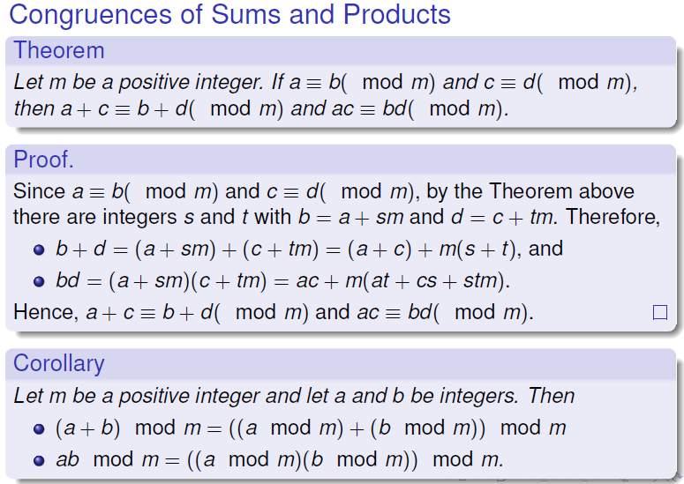
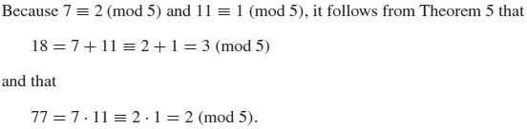

Slide 15
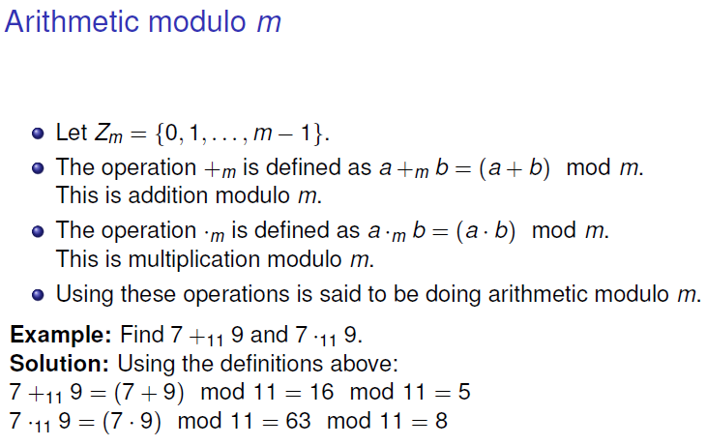

Slide 16
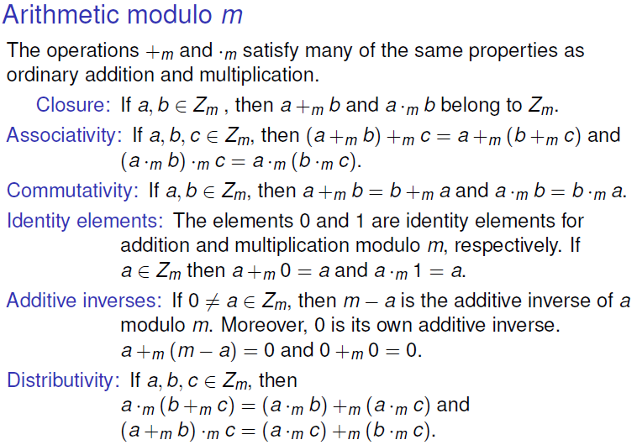

Slide 17
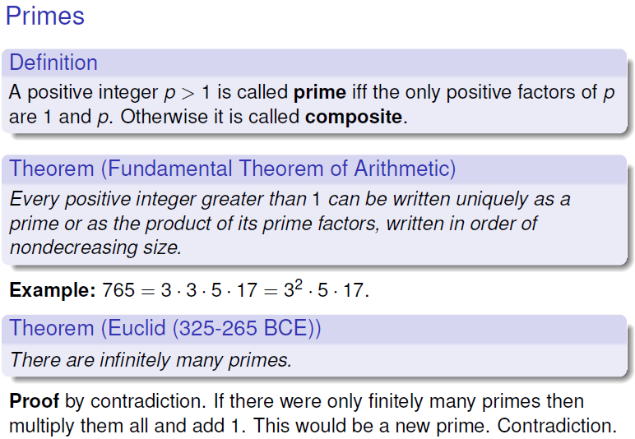

Slide 18
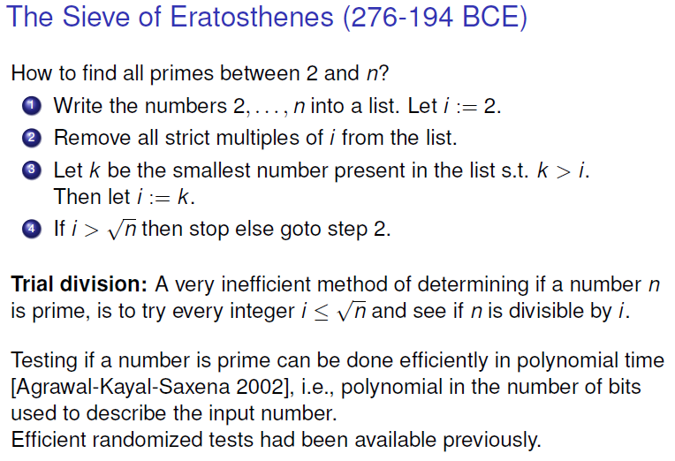

Slide 19
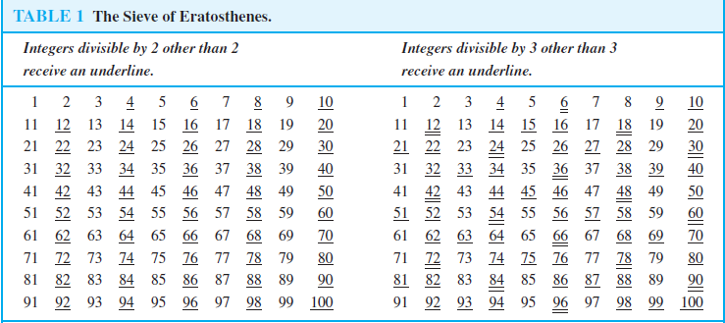

Slide 20
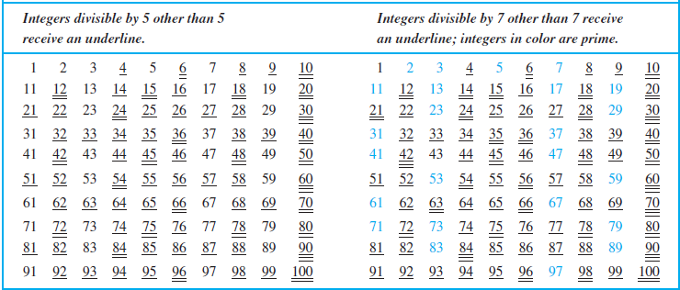

Slide 21
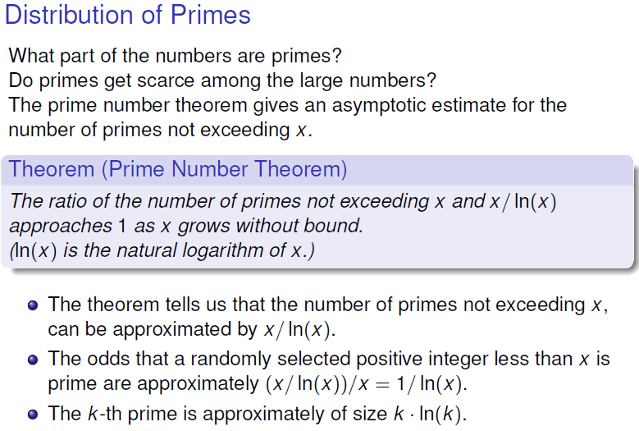
For example, 100 / ln(100) = 21.71
For example, the odds that an integer near 10¹⁰⁰⁰ is prime are approximately 1/ ln 10¹⁰⁰⁰, which is approximately 1/2300.

Slide 22
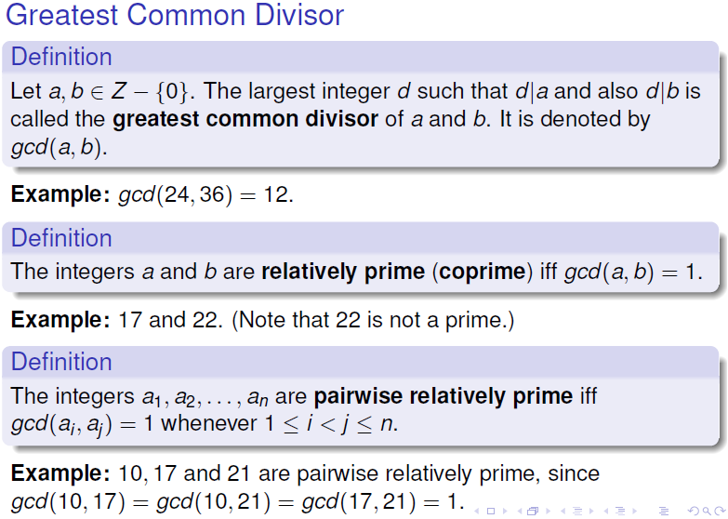

Slide 23
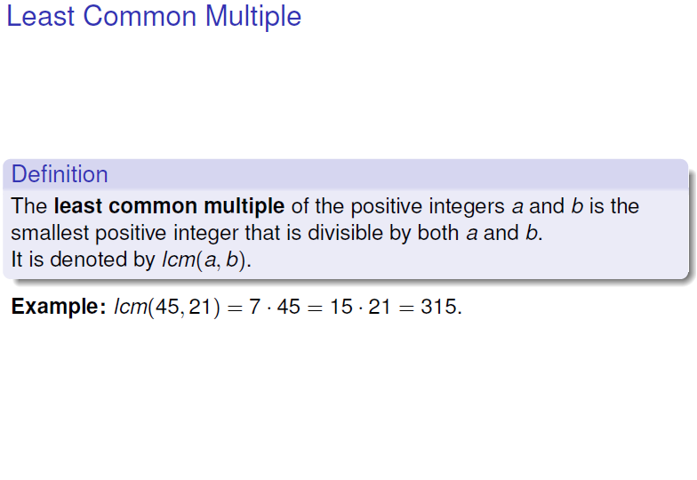

Slide 24
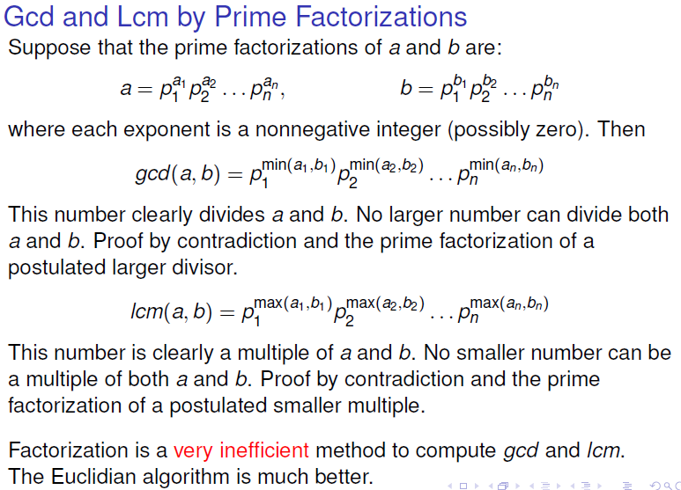

Slide 25
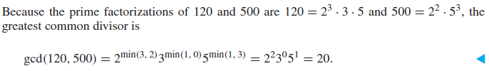
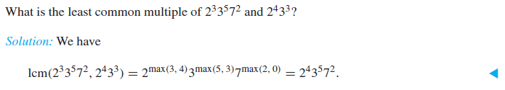

Slide 26
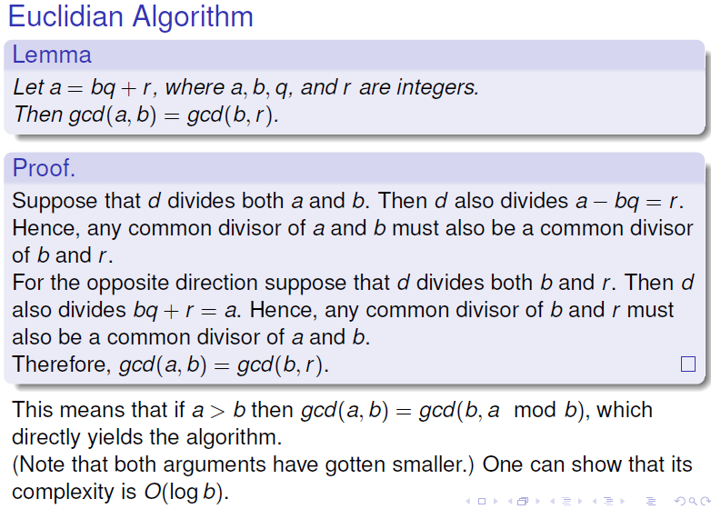

Slide 27
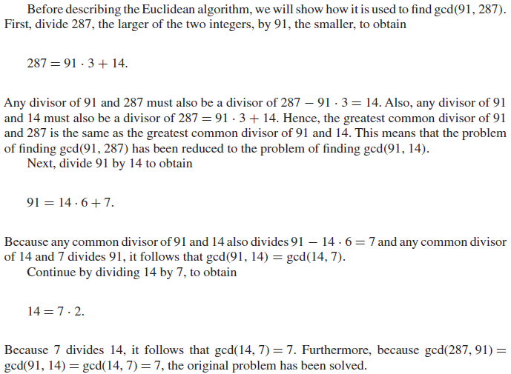

Slide 28
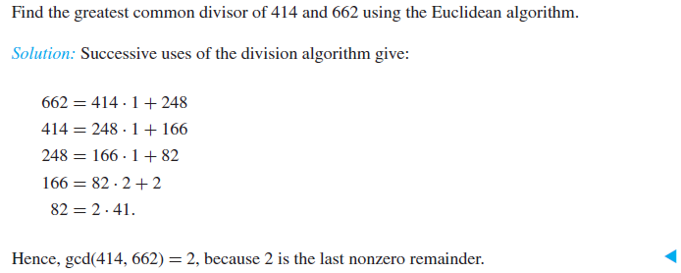

Slide 29
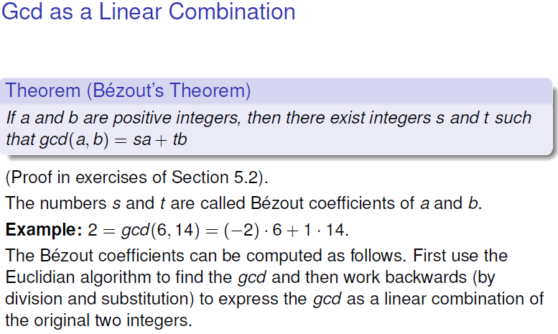

Slide 30
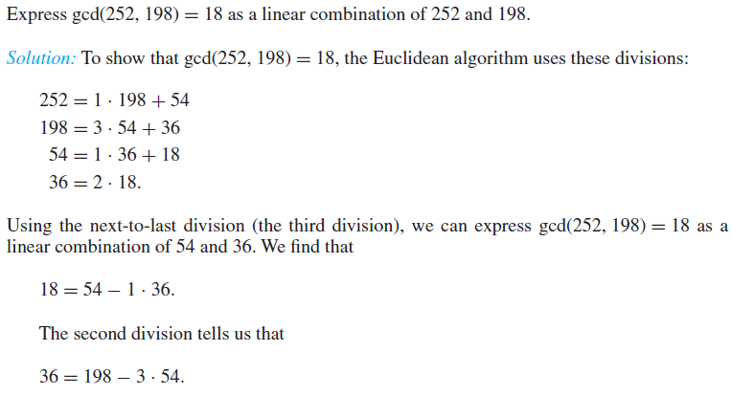

Slide 31
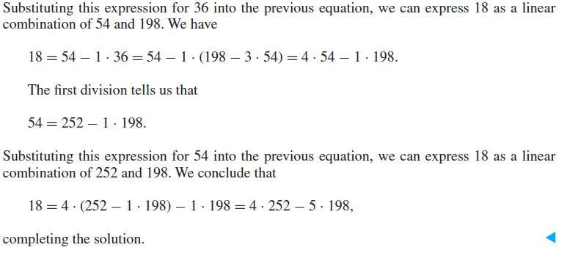

Slide 32
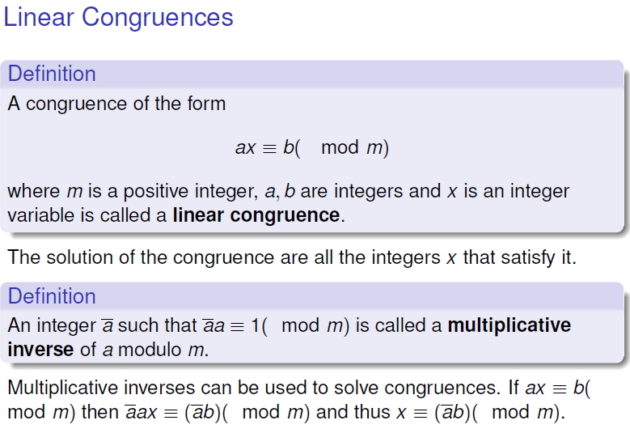

Slide 33
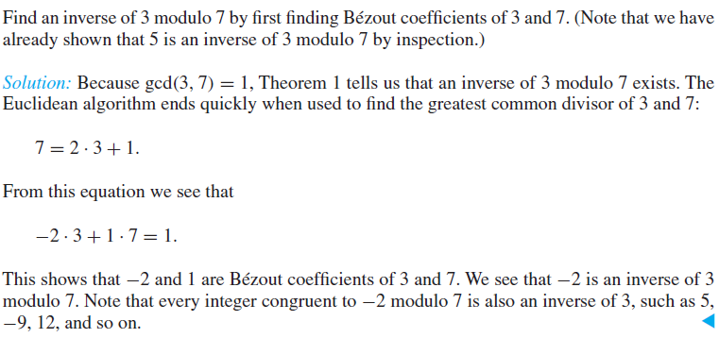

Slide 34
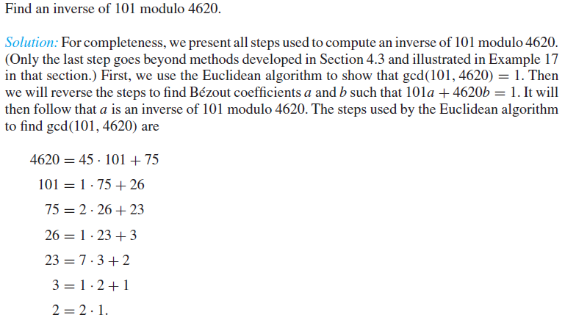

Slide 35
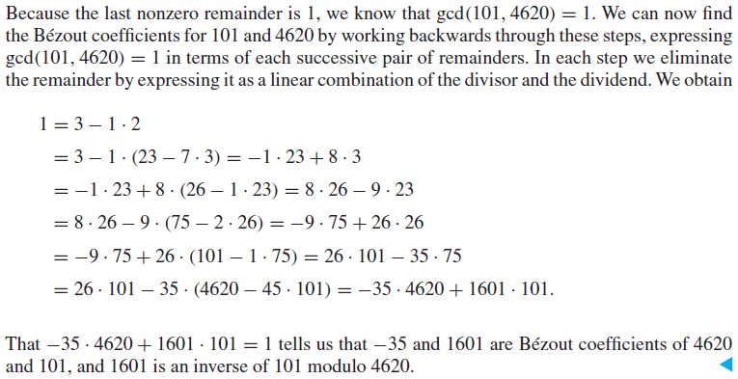

Slide 36
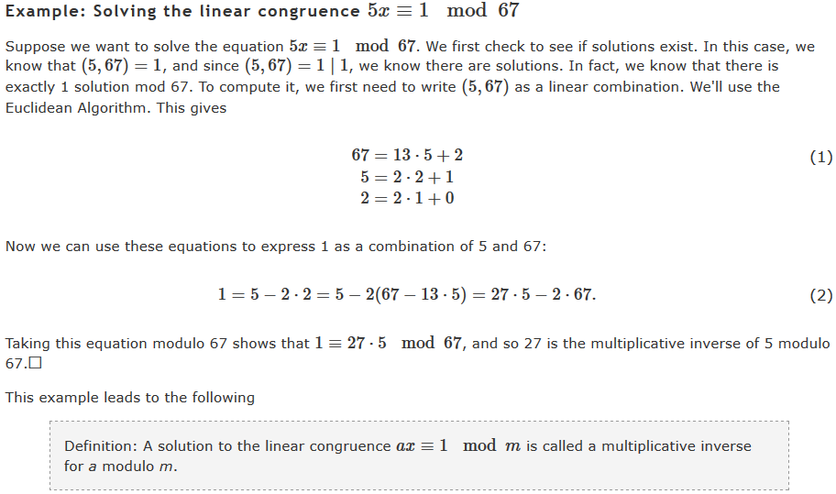

Slide 37
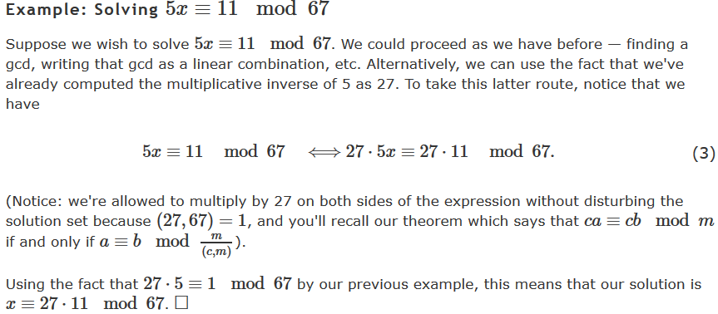

Slide 38
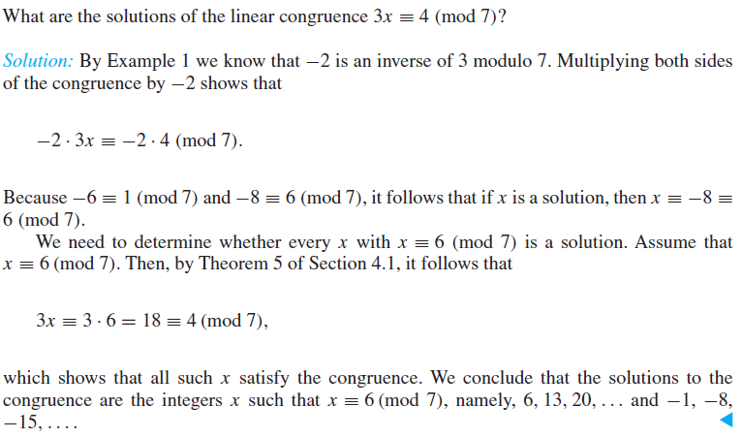

Slide 39
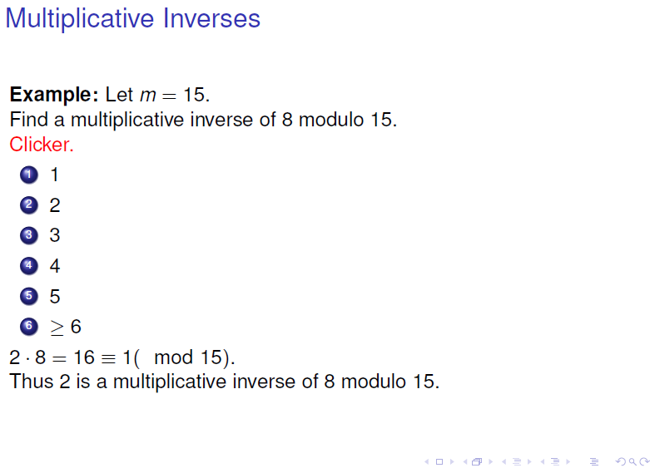

Slide 40
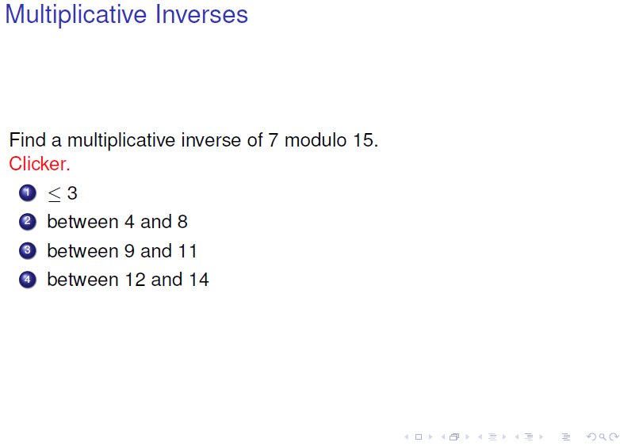

Slide 41
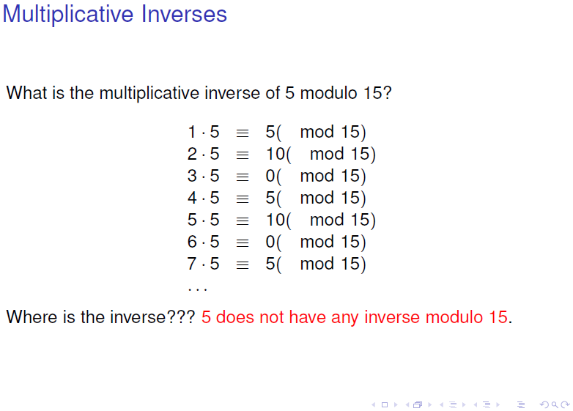

Slide 42
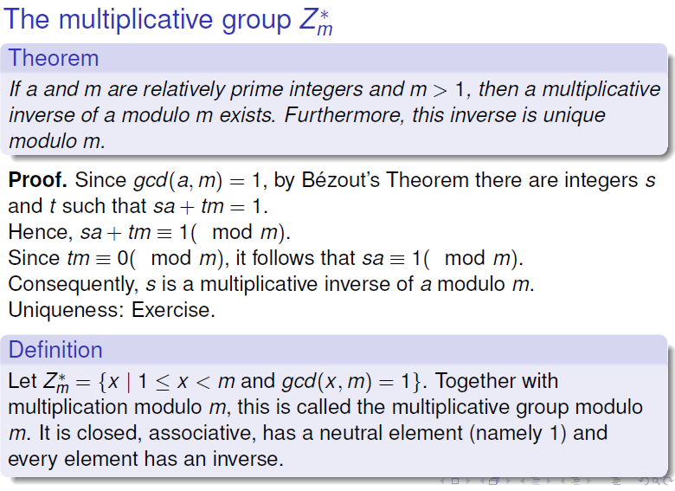

Slide 43
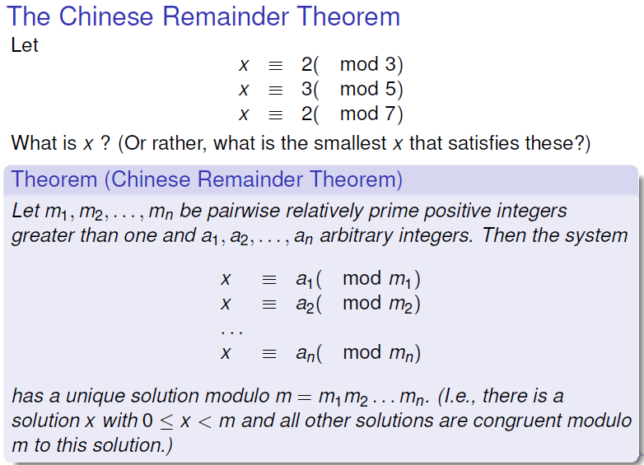

Slide 44
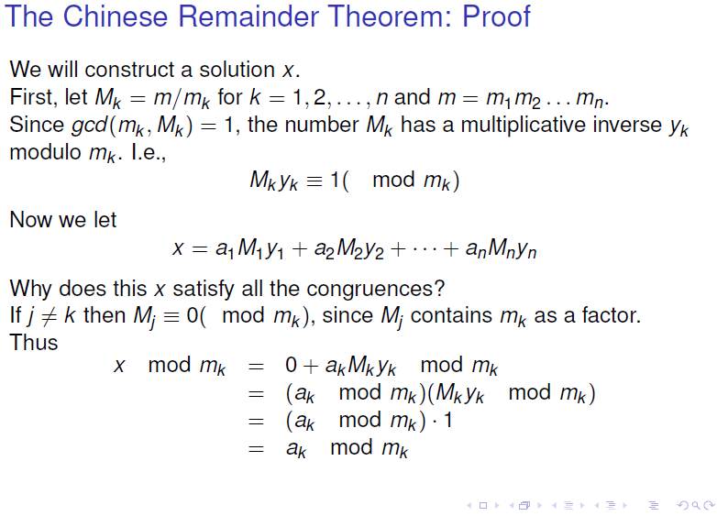

Slide 45

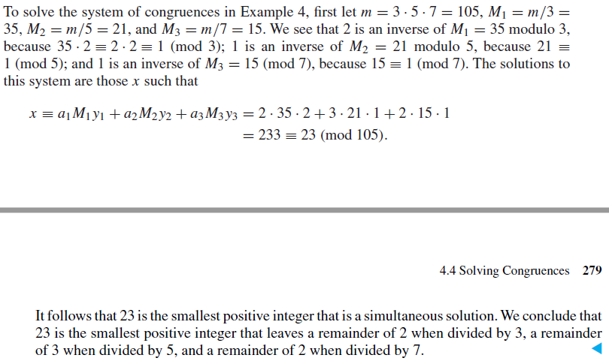
Notes:
32 mod 83
70 mod 112
30 mod 135
m= 1254960 M1=1254960/83= 15120 M2=11205 M3=9296
6
45
71

Slide 46
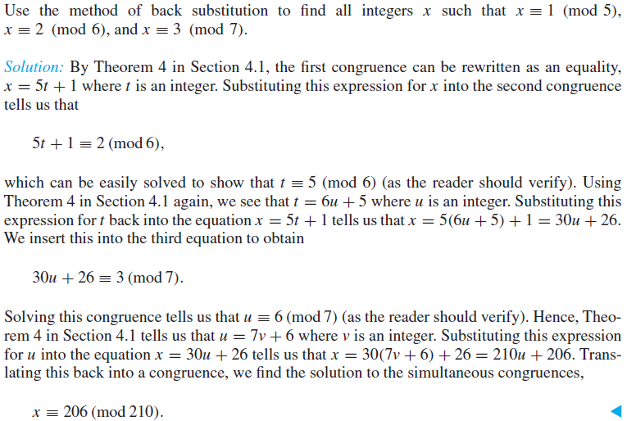

Slide 47
Problem: Jessica breeds rabbits. She's not sure exactly how many she has today, but as she was moving them about this morning, she noticed some things. When she fed them, in groups of 5, she had 4 left over. When she bathed them, in groups of 8, she had a group of 6 left over. She took them outside to romp in groups of 9, but then the last group consisted of only 8. She's positive that there are fewer than 250 rabbits - but how many does she have?

Slide 48
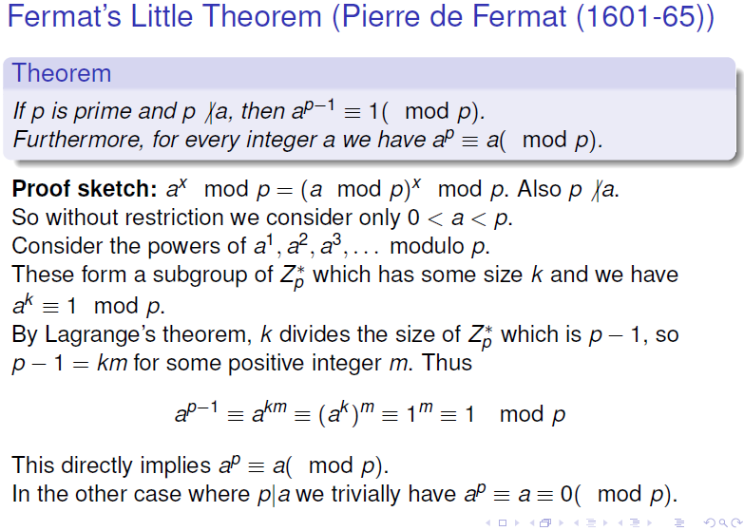

Slide 49


Slide 50


Slide 51


Slide 52


Slide 53


Slide 54


Slide 55

`

Slide 56


Slide 57
The RSA Algorithm
To generate a key pair:
– Pick large primes p and q (do not disclose them)
– Let n = p*q
– For the public key, choose e that is relatively prime to ø(n)=(p-1)(q-1).
public key = <e,n>
– For private key, find d that is the multiplicative inverse of e mod ø(n), i.e., e*d

Slide 58
Using RSA
Given pubKey = <e, n> and privKey = <d, n>
If Message = m
Then:
encryption: c = m^{e} mod n, m < n
decryption: m = c^{d} mod n
signature: s = md mod n, m < n
verification: m = se mod n

Slide 59
Example of RSA (1)
Choose p = 7 and q = 17.
Compute n = p*q= 119.
Compute f(n)=(p-1)(q-1)=96.
Select e = 5, (a relatively prime to f(n).)
Compute d = _77_such that e*d=1 mod f(n).
• Public key: <5,119>
• Private key: <77,119>
• Message = 19
• Encryption: 19⁵ mod 119 = 66
• Decryption: 66⁷⁷ mod 119 = 19

Slide 60
Example of RSA (2)
p = 7, q = 11, n = 77
Alice chooses e = 17, making d = 53
Bob wants to send Alice secret message
HELLO (07 04 11 11 14)
– 07¹⁷ mod 77 = 28; 04¹⁷ mod 77 = 16
– 11¹⁷ mod 77 = 44; – 11¹⁷ mod 77 = 44
– 14¹⁷ mod 77 = 42
• Bob sends 28 16 44 44 42

Slide 61
Example of RSA (3)
Alice receives 28 16 44 44 42
Alice uses private key, d = 53, to decrypt message:
– 28⁵³ mod 77 = 07; 16⁵³ mod 77 = 04
– 44⁵³ mod 77 = 11; 44⁵³ mod 77 = 11
– 42⁵³ mod 77 = 14
• Alice translates 07 04 11 11 14 to HELLO
No one else could read it, as only Alice knows her
private key (needed for decryption)

Slide 62


